Slide 1
Biomechanics of Sport Injury
University of Birjand
Faculty of Sport Sciences
Dr. Saeed Ilbeigi

Slide 2
Introduction
The identification of cause and reason of injury and also improved protection against injury can be realized through a better understanding of the biomechanics of injury and disability.

Slide 3
Introduction
Although physical activity is associated with an overall reduction in mortality, morbidity and an improved quality of life, it also carries an increased risk of injury and disability.

Slide 4
Sports biomechanics
Sports biomechanics has often been described as having two aims that may be incompatible:
the reduction of injury
the improvement of performance

Slide 5
Why Biomechanics of Injury
Injury biomechanics research uses the principles of mechanics to explore the mechanisms of physical and physiologic responses to mechanical forces.

Slide 6
Why Biomechanics of Injury
Research in biomechanics involves a variety of disciplines, including:
engineering, physiology, medicine, biology, and anatomy.

Slide 7
How can biomechanics prevent sports injuries?
Experiencing an injury in any sport is impossible to avoid, but it has been found new ways that may be able to reduce the amount of occurrences.
The studies are led by analyzing biomechanics, which is designed to simplify the way we understand the motion of the human body.
Biomechanics has been found highly effective in preventing injuries ,but how?

Slide 8
Causes of injury
Injury can be defined as follows: Injury occurs when the load applied to a tissue exceeds its failure tolerance

Slide 9
Load-Deformation
The term ‘load’ will be used to mean the sum of all the forces and moments acting on the body or a specific tissue structure (e.g. Nigg, 1993).
When a material is loaded, it undergoes deformation because the atomic bonds bend, stretch or compress.

Slide 10
Measuring the Mechanical Properties of Body Tissues
Bone, tendon, ligament, and muscle are some of the basic structures that make up the human body.
The mechanical properties of structures; the external forces that are applied to the structure and relate them to the resulting deformation of the structure

Slide 11
The ability of a structure to resist deformation depends on its material organization and overall shape.

Slide 12
Strength and Stiffness of Tissue
evaluated using relationship between
applied load and amount of deformation
LOAD - DEFORMATION CURVE
Tissue Characteristics
Anisotropic
Viscoelastic
Elastic
Plastic

Slide 13
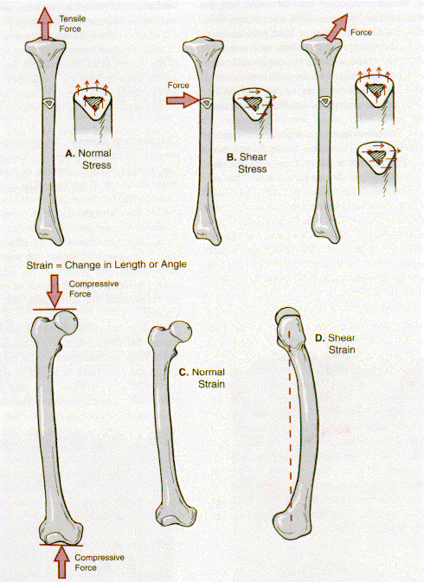
Strain = Change in Length/Angle
Stress = Force/Area
Note: Stress-Strain curve is a normalized Load-Deformation Curve

Slide 14
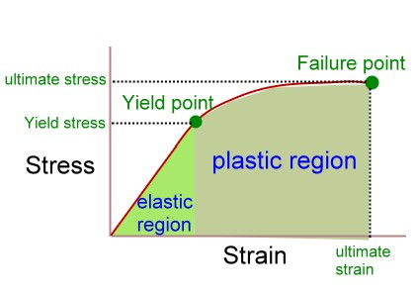
Stress and Strain curve

Slide 15
stress-strain curve
A stress-strain curve of a structure can be used to discern how a material :
changes with age,
how materials react to different force applications,
and how a material reacts to lack of everyday stress.
Mechanical Property of the Tissue

Slide 16
A number of key points on this curve are important to the ultimate function of the structure.

Slide 17
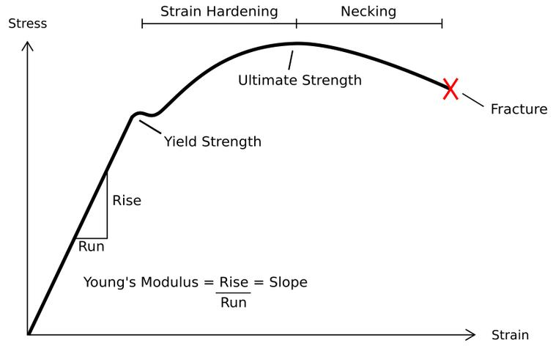
stress-strain curve
In this curve, the slope of the linear portion of the curve is the elastic modulus, or stiffness of the material.

Slide 18
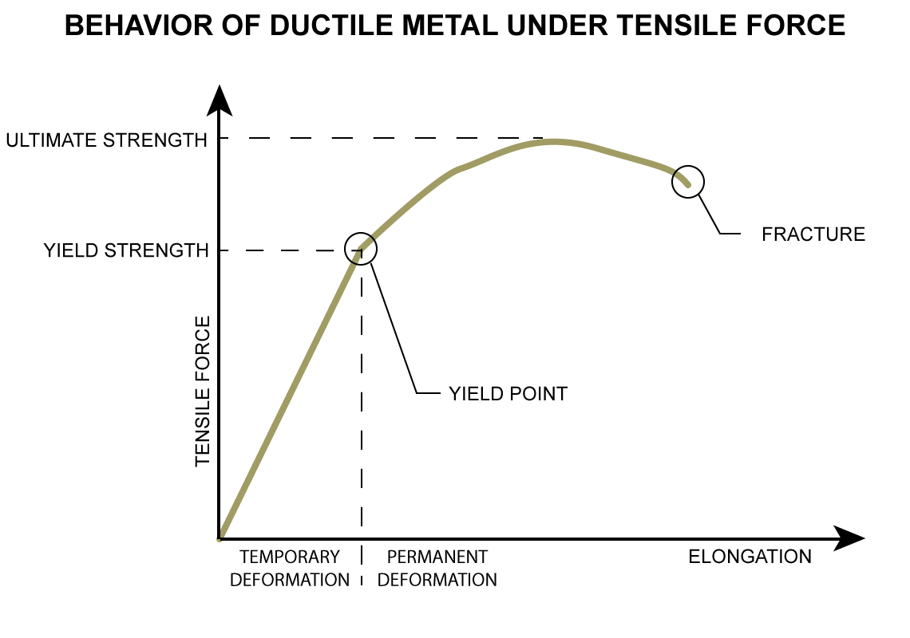
As greater force is applied to the structure, the slope of the curve eventually decreases. At this point, the structure is said to yield or reach its yield point.

Slide 19
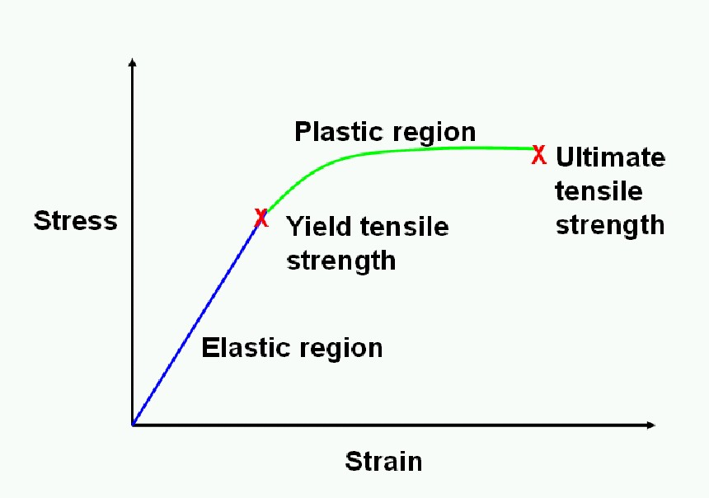
elastic region
Up to the yield point, the structure is said to be in the elastic region.
If the stress is removed while the material is in this region, the material will return to its original length with no structural damage.

Slide 20
Plastic Region
After the yield point, the molecular components of the material are permanently displaced with respect to each other, and if the applied force is removed, the material will not return to its original length
The region after the yield point is the plastic region

Slide 21
Elastic & Plastic responses
plastic region
fracture/failure
elastic
region
elastic thru 3%deformation
plastic response leads to fracturing
Strength defined by failure point
Stiffness defined as the slope of the
elastic portion of the curve
Stress (Load)
Δstress
Δstrain
Strain (Deformation)

Slide 22
For rigid materials, such as bone, the yield or plastic region is relatively small, but for other materials, it can be relatively large.
If the applied force continues beyond the plastic region, the structure will eventually reach failure, at which point the stress quickly falls to zero. The maximal stress reached when failure occurs determines the failure strength and failure strain of the material.

Slide 23
Conclusion
In normal functional activities, the stress applied will not cause a strain that reaches the yield point.
…but in some sport and exercise; that can be created the trauma and injury:
…..the strain can reached into the plastic and finally fracture point.

Slide 24
Mechanical Properties of structure
The mechanical properties of structure/bone are as complex and varied as its composition.
The measurement of bone strength, stiffness, and energy depends on both the material composition and the structural properties of bone.

Slide 25
Mechanical Properties of structure
the mechanical properties also vary with age and gender and with the location of the bone, such as the humerus versus the tibia.

Slide 26
Mechanical Properties of structure
Additional variation may result from other factors such as :
orientation of load applied to the bone, rate of load application,
and type of load.

Slide 27
Bone must be capable of withstanding a variety of imposed forces simultaneously.
In a static position, bone resists the force of gravity, supports the weight of the body, and absorbs muscular activity produced to maintain the static posture.
In a dynamic mode such as running, the forces are magnified many times and become multidirectional.

Slide 28
Strength and Stiffness of Bone
The behavior of any material under loading conditions is determined by its strength and stiffness
The strength can be evaluated by examining the relationship between the load imposed (external force) and the amount of deformation (internal reaction) occurring in the material.

Slide 29
Bone- Structural Properties
bone must be stiff yet flexible and strong yet light.
Strength is necessary for load bearing, and lightness is necessary to allow movement.
The strength in weight-bearing bones lies in their ability to resist bending by being stiff.
Flexibility is needed to absorb high-impact forces, and the elastic properties of bone allow it to absorb energy by changing shape without failing and then return to its normal length.

Slide 30
In conclusion:
If the imparted energy exceeds the zone of elastic deformation, plastic deformation occurs and create microdamage to the bone.
If both the elastic and plastic zones are exceeded, the imparted energy is released in the form of a fracture.

Slide 31
Strength
The strength of bone or any other material is defined by the failure point or the load sustained before failure.
The overall ability of bone to bear a load depends on having sufficient bone mass with adequate material properties
as well as fiber arrangement that resist loading possibilities in different directions

Slide 32
Strength of bone is provided by the mineralization of its tissue:
the greater the tissue mineral content, the stiffer and stronger the material.
If bone becomes too mineralized, however, it becomes brittle and does not give during impact loading

Slide 33
Stiffness
Stiffness, or the modulus of elasticity, is determined by the slope of the load deformation curve in the elastic response range and is representative of the material's resistance to load as the structure deforms

Slide 34
Bone and deformation
Bone is not as stiff as glass or metal, and unlike these materials, it does not respond in a linear fashion because it yields and deforms nonuniformly during the loading phase.
Bone has a much lower level of stiffness than metal or glass and fractures after very little plastic deformation.

Slide 35
At the onset of loading, bone exhibits a linearly elastic response. When a load is first applied, a bone deforms through a change in length or angular shape.
Bone deforms no more than approximately 3%

Slide 36
This is considered in the elastic region of the stress-strain curve because when the load is removed, the bone recovers and returns to its original shape or length

Slide 37
With continued loading, the bone tissue reaches its yield point, after which its outer fibers begin to yield, with microtears and debonding of the material in the bone. This is termed the plastic region of the stress-strain curve.
The bone tissue begins to deform permanently and eventually fractures if loading continues in the plastic region.

Slide 38
Finally…
Thus, when the load is removed, the bone tissue does not return to its original length but stays permanently elongated.

Slide 39
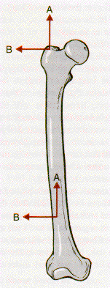
Anisotropic Characteristics
Bone tissue is an anisotropic material, which means that the behavior of bone varies with the direction of the load application
Bone can handle large forces applied in the longitudinal direction.
Bone is not as strong in handling forces applied transversely across its surface

Slide 40
Viscoelastic Characteristics
Bone is considered viscoelastic because it responds differently when loaded at different rates.
When loaded quickly, bone responds with more stiffness and can handle a greater load before fracturing.
When loaded slowly, bone is not as stiff or strong, fracturing under lower loads.

Slide 41
Viscoelastic Response
behavior of bone is dependent
on rate load is applied
Bone will fracture sooner
when load applied slowly
fracture
Load
fast
fracture
slow
deformation

Slide 43
Different Types of Loads Acting on Bone
Load | Type of Force | Source | Stress/Strain
Compression | Presses ends of bones together to cause widening and shortening | Muscles, weight bearing, gravity or external forces | Maximal stress on the plane perpendicular to the applied load
Tension | Pulls or stretches bone to cause lengthening and narrowing | Usually pull of contracting muscle tendon | Maximal stress on the plane perpendicular to the applied load
Shear | Force applied parallel to surface, causing internal deformation in an angular direction | Compressive or tension force application or external force | Maximum stress at on the plane parallel to the applied load
Bending | Force applied to bone having no direct support from the structure | Weight bearing or multiple forces applied at different points on the bone | Maximum tensile forces on the convex surface of the bent member and maximum compression forces on the concave side
Torsion | Twisting force | Force applied with one end of the bone fixed | Maximum shear stress on both the perpendicular and parallel to axes of bone with tension and compression forces also present at an angle across the surface

Slide 44
Load | Type of Force | Source | Stress/Strain
Compression | Presses ends of bones together to cause widening and shortening | Muscles, weight bearing, gravity or external forces | Maximal stress on the plane perpendicular to the applied load
Tension | Pulls or stretches bone to cause lengthening and narrowing | Usually pull of contracting muscle tendon | Maximal stress on the plane perpendicular to the applied load

Slide 45
Load | Type of Force | Source | Stress/Strain
Shear | Force applied parallel to surface, causing internal deformation in an angular direction | Compressive or tension force application or external force | Maximum stress at on the plane parallel to the applied load
Bending | Force applied to bone having no direct support from the structure | Weight bearing or multiple forces applied at different points on the bone | Maximum tensile forces on the convex surface of the bent member and maximum compression forces on the concave side

Slide 46
Load | Type of Force | Source | Stress/Strain
Torsion | Twisting force | Force applied with one end of the bone fixed | Maximum shear stress on both the perpendicular and parallel to axes of bone with tension and compression forces also present at an angle across the surface

Slide 47
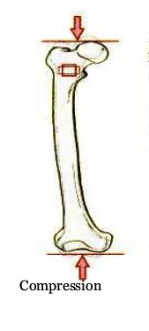
Compression Forces
Compressive forces are necessary for development and growth in the bone.
If a large compressive force is applied and if the load surpasses the stress limits of the structure, a compression fracture will occur.
E.g…. The lumbar vertebrae can incur compressive fracture
patellar pain
compressive force at the hip joint …

Slide 48
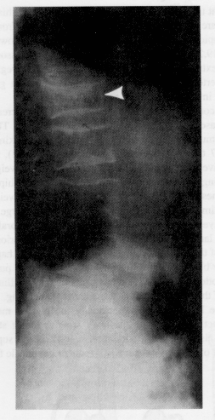
Compressive Loading
Vertebral fractures
cervical fractures
spine loaded through head
e.g., football, diving, gymnastics
once “spearing” was outlawed
in football the number of cervical
injuries declined dramatically
lumbar fractures
weight lifters, linemen, or gymnasts
spine is loaded in hyperlordotic
(aka swayback) position

Slide 49
Tension Forces
When muscle applies a tensile force to the system through the tendon, the collagen in the bone tissue arranges itself in line with the tensile force of the tendon.
Responsible of apophyses, bony outgrowths such as processes, tubercles, and tuberosities, Avulsion fractures …

Slide 50
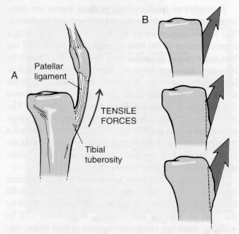
Tensile Loading
Main source of tensile load is muscle
tension can stimulate tissue growth
fracture due to tensile loading is usually an avulsion
other injuries include sprains, strains, inflammation, bony deposits
when the tibial tuberosity experiences excessive loads from quadriceps
muscle group develop condition known as Osgood-Schlatter’s disease

Slide 51
Shear Forces
Shear forces are responsible for some vertebral disc problems, such as spondylolisthesis, in which the vertebrae slip anteriorly over one another.
Fracture of the distal femoral epiphysis is usually created by shear force

Slide 52
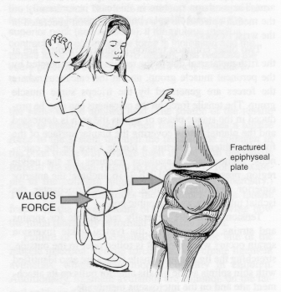
Shear Forces
created by the application of compressive, tensile or a combination of these loads

Slide 53
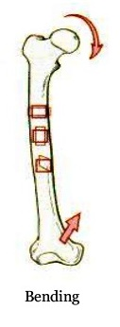
Bending Forces
Bone is regularly subjected to large bending forces. For example, during gait, the lower extremity bones are subjected to bending forces caused by alternating tension and compression forces.
Also, weight bearing produces an anterior bend in the tibia. Although these bending forces are not injury producing, the bone is strongest in the regions where the bending force is greatest

Slide 54
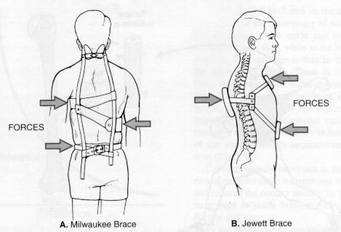
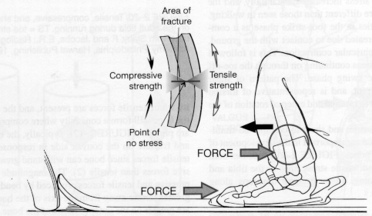
Bending Forces
Usually a 3- or 4-point
force application

Slide 55
torsional force
Fractures resulting from torsional force can occur in the humerus when poor throwing technique creates a twist on the arm and in the lower extremity when the foot is planted and the body changes direction. Torsional loading of the lower extremity is also responsible for knee cartilage and ligament injuries. and can occur when the foot is caught while the body is spinning

Slide 56
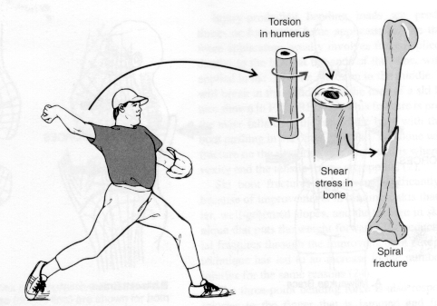
Torsional Forces
Caused by a twisting force
produces shear, tensile, and
compressive loads
tensile and compressive loads are
at an angle
often see a spiral fracture develop
from this load

Slide 57
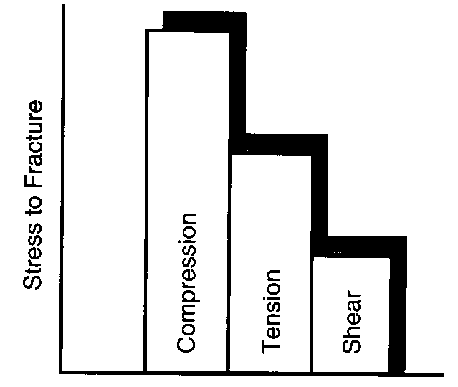
Comparison of Forces

Slide 58
Elastic Biomaterials (Bone)
Elastic/Plastic characteristics
Brittle material fails before
permanent deformation
Ductile material deforms
greatly before failure
Bone exhibits both properties
Load/deformation curves
elastic
limit
load
ductile material
brittle material
bone
deformation (length)

Slide 59
Cnoclusion
An injury occurs when the stress applied to a tissue is greater than its ability to ‘absorb’ the stress acutely or chronically. This results from complex interactions between internal and external risk factors.

Slide 60
Impact injury of the human body occurs by deformation of tissues beyond their failure limits, which results in damage of anatomic structures or alteration in function.
Even if there is recovery from structural injury, normal physiologic function does not always return.
For example, bony fractures can heal, but associated damage to the central nervous tissue might result in a permanent loss of motor and sensory function.

Slide 61
Mechanisms of Injury
The severity of an impact depends not only on the velocity of the collision that produces it, but also on the shapes of the objects and their rigidity and also the type of forces that applied.
It can be reduced by energy-absorbing structures and padding material by allowing simultaneous deformation of the body.

Slide 62
Because of the inertial resistance of the tissues and the elastic and viscous of the body structures, force is developed on the body during impact.
Force deforms and accelerates the body. Injury (Figure 4-1) can be caused by:

Slide 63
Figure 1:
Three principal mechanisms of impact injury:
left, compression of the body and injury when the crush exceeds elastic tolerances;
center, high-speed impact with injury when violence exceeds viscous tolerance;
right, body acceleration when internal organ motion lags the skeleton with injury due to organ inertia.

Slide 64
Crushing deformation of the body, such as through chest compression, rib fracture, and aortic laceration.
Impulsive impact, such as by violent sternal motion that deforms the heart beyond its viscous tolerance and causes contusion and rupture.
Acceleration of the skeleton and tearing of internal organs, because of their inertia; for example, during head impact, the skull accelerates and the loosely attached brain lags,so injury is due in part to deformation of brain tissues beyond their limit of recovery.

Slide 65
A mechanism of injury involves the mechanical deformations and physiologic responses that cause an anatomic lesion or functional change.
Knowledge of injury mechanisms is fundamental to the science of injury biomechanics, because it points to the appropriate biomechanical measurements that characterize injuries.

Slide 66
viscoelastic tissues
The human body has viscoelastic tissues that absorb energy and protect vital organs from the effects of impact.

Slide 67
As long as the energy delivered to the tissue is below the limit of injury energy will be absorbed without causing injury.
The resistance of the human body to impact is responsible for survival of falls from extreme heights and survival of severe motor-vehicle crashes.

Slide 68
Effective injury-prevention strategies must be based on knowledge of the mechanisms of injury and disability, as well of the body's biomechanical responses and tolerances and techniques for assessing the injury-prevention benefits of safety technology.

Slide 69
Deformation of tissues beyond a recoverable limit is the most common origin of injury.
From an engineering point of view, deformation of a tissue or structure is measured according to change in shape (such as the change in length divided by the initial length) or strain.
The two main types of strain (Figure 4-2) that can damage tissue are tensile strain and shear strain; a third type is compressive strain, which is responsible for crushing injuries. And also Torsion and Bending.

Slide 70
Figure: 2
Stretch of vessel can tear tissue (partial tear shown) with loss or containment of blood.
Opposing forces across vessel can cause shear injury (complete tear shown) with or without loss of blood.

Slide 71
Stretching of an artery increases its length and increases strain. If the strain is too great, the tissue will break. There are many ways to stretch tissue and thus produce tensile strain.

Slide 72
For example, the motion of the heart during chest compression stretches the aorta near points of attachment; the stretch is primarily along the axis of the vessel and generally leads to a transverse laceration when the recoverable limit of tissue strain is exceeded.
An increase in vascular pressure enlarged blood vessels and produces tensile strain in the tissue; in this case, the strain is in both axial and transverse directions (i.e., it is biaxial), and pressures beyond the recoverable limit cause a bursting of the tissue.

Slide 73
Shear strain occurs when forces oppose each other across a tissue (see Figure 4-2). The movement of tissue in opposite directions separates it when the recoverable limit is exceeded.

Slide 74
Figure: 3
Vessels beneath skin can be torn by stretch or shear with laceration of skin, resulting in bruise, or contusion.

Slide 75
Stretch and shear of tissue are the primary mechanisms of laceration, fracture, rupture, and avulsion in the human body.

Slide 76
Deformation or strain is also a principal factor in contusion injury (Figure 4-3). In this case, the surface of the tissue is not damaged, but the deformations stretch and shear internal vessels and increase intraluminal pressures, which can damage vessels and initiate hemorrhage.

Slide 77
The rate of loading, or strain rate, is important in the production of injury. Biologic tissues are viscoelastic, and their response and tolerance depend on both strain and strain rate.
For example, compact bone fails at a lower strain applied at higher rates, even though the load it carries at failure is higher.

Slide 78
The rate of loading is critical in soft-tissue injury, particularly when the viscous tolerance of the tissue is exceeded.This tolerance is proportional to the product of loading rate and amount of compression. The faster a tissue is loaded, the lower is its tolerance to compression. The viscous injury mechanism is important in cases of high-speed impact, particularly when rupture and contusion occur.

